Slide 1
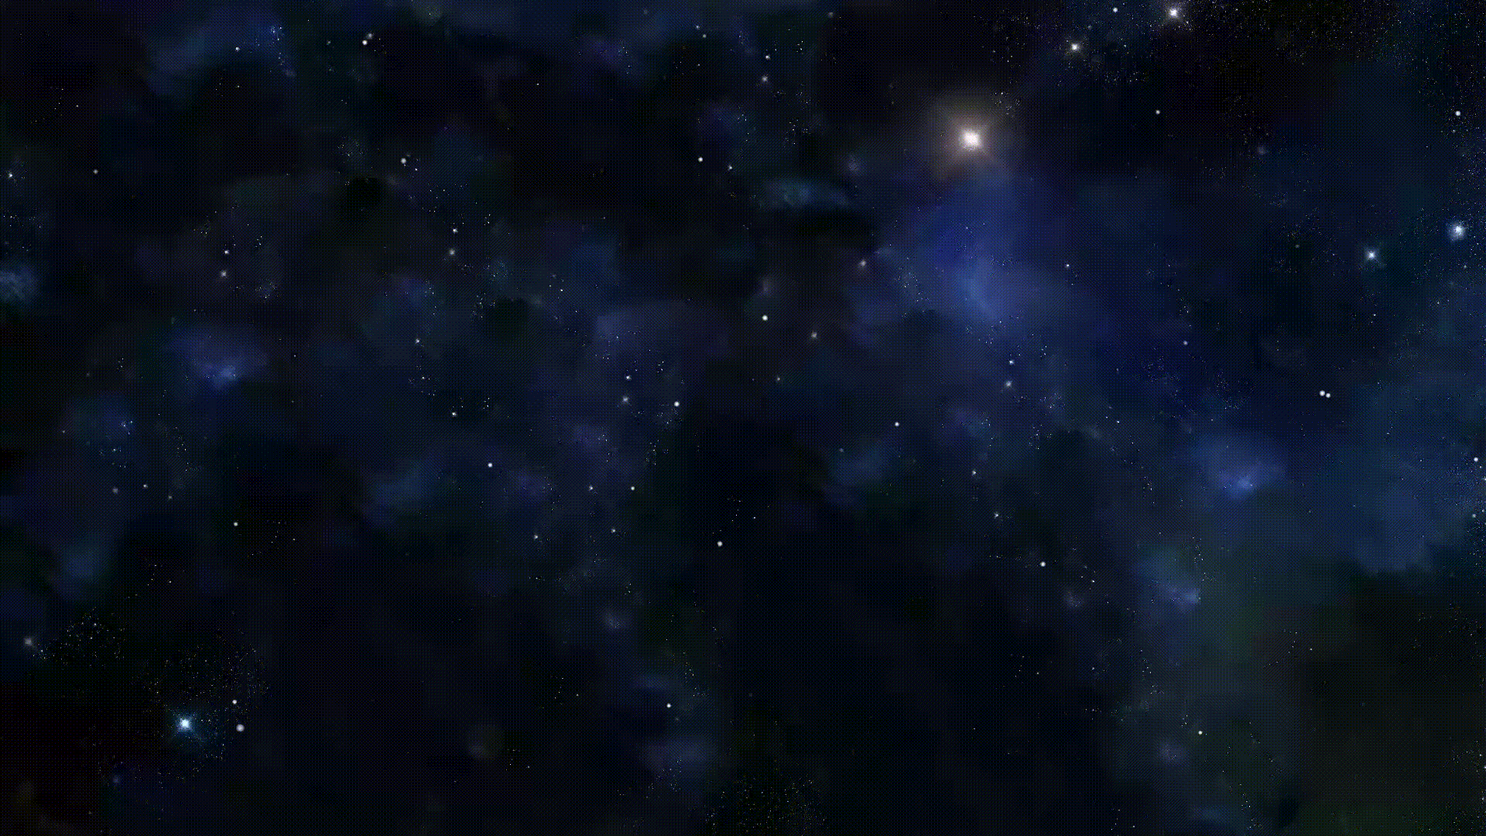

Sunday, 7 December 2025
Kiosk: P1
G O O D M O R N I N G
WELCOME TO MULTIVERSE STUDIOS.
You are currently at:
PORTAL PLAZA .
📍
MAIN ENTRANCE
––––––––– TOUCH TO INTERACT –––––––––
Notes:
Background: https://commons.wikimedia.org/wiki/File:Backgorund.gif
Icons: Google Material Icons

Slide 2
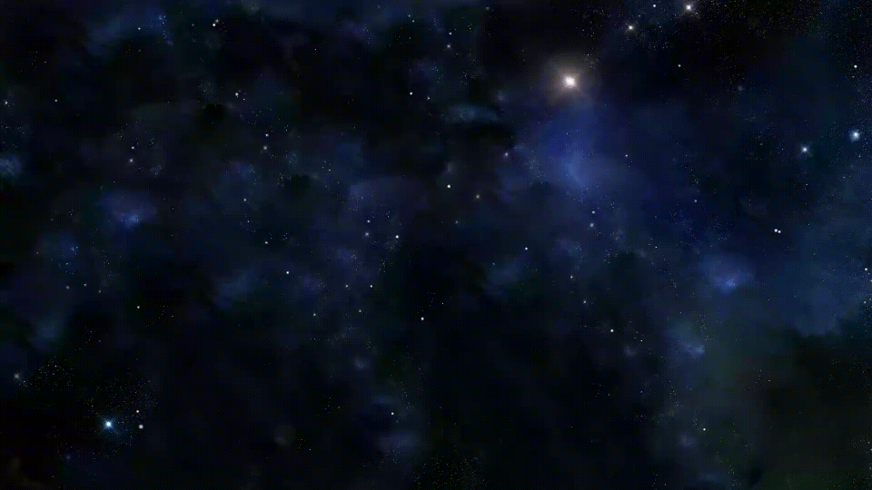




Sunday, 7 December 2025
Kiosk: P1
Back
Enter a group name…
––––––––– Add Members –––––––––
1.
Enter name…
Scan face
Many people, One itinerary
2.
Enter name…
Scan face
Create Group
3.
Enter name…
Scan face
4.
Enter name…
Scan face
Skip
Add more members
Submit
Notes:
Background: https://commons.wikimedia.org/wiki/File:Backgorund.gif

Slide 3
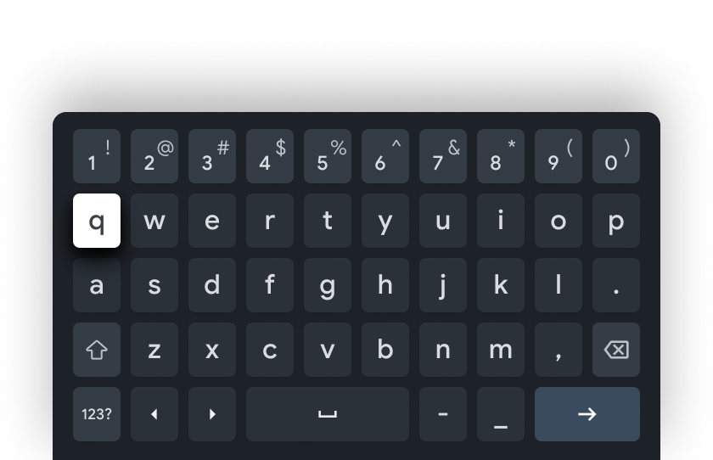
Sunday, 7 December 2025
Kiosk: P1
Back
|
––––––––– Add Members –––––––––
1.
Enter name…
Scan face
Many people, One itinerary
2.
Enter name…
Scan face
Create Group
3.
Enter name…
Scan face
4.
Enter name…
Scan face
Skip
Add more members
Submit
Notes:
Background: https://commons.wikimedia.org/wiki/File:Backgorund.gif
Keyboard: https://developer.android.com/static/training/tv/images/atv-keyboard-password.png

Slide 4








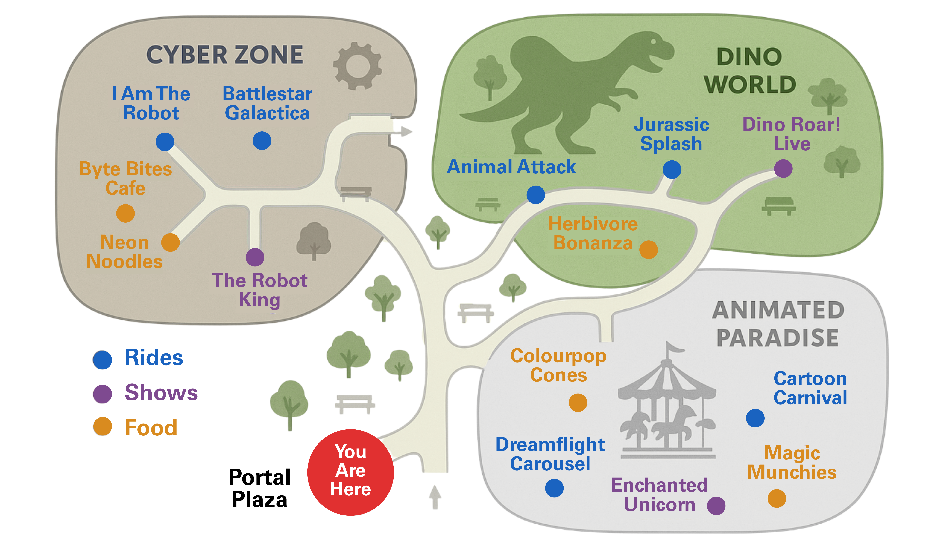








Sunday, 7 December 2025
Kiosk: P1
Rides
Shows
Food
Wait times
Refresh
Filters:
Updated: 1 min ago
Expand
Expand
––––––––– All Attractions List –––––––––
750m away
Map
The Robot King, 750m away
📍Cyber Zone, Shows
Add To Plan
EMOTION ENGINE
Battlestar Galactica, 800m away
📍Cyber Zone, Rides
Add To Plan
Directions
I Am The Robot, 880m away
📍Cyber Zone, Rides
Add To Plan
1
Byte Bites Cafe, 910m away
Plan
📍Cyber Zone, Food
Add To Plan
Neon Noodles, 870m away
📍Cyber Zone, Food
Add To Plan
History
––––––––– My Plan –––––––––
Animal Attack, 680m away
Animal Attack, 680m away
Added: 10 min ago
📍Dino World, Rides
Remove Plan
1.
📍Dino World, Rides
Remove Plan
Jurassic Splash, 720m away
📍Dino World, Rides
Add To Plan
Dino Roar! Live, 940m away
📍Dino World, Shows
Add To Plan
Logout
Notes:
Background: https://commons.wikimedia.org/wiki/File:Backgorund.gif
Map generated by Gen_AI (ChatGPT), further edited using Canva

Slide 5

Sunday, 7 December 2025
Kiosk: P1
Rides
Shows
Food
Wait times
Refresh
Filters:
Updated: 1 min ago
Expand
Expand
––––––––– All Attractions List –––––––––
750m away
Map
The Robot King, 750m away
📍Cyber Zone, Shows
Add To Plan
EMOTION ENGINE
Battlestar Galactica, 800m away
ⓘ
Close
📍Cyber Zone, Rides
Add To Plan
Directions
I Am The Robot, 880m away
Confirm add to plan:
📍Cyber Zone, Rides
Add To Plan
1
The Robot King, 750m away
Byte Bites Cafe, 910m away
Plan
📍Cyber Zone, Shows
📍Cyber Zone, Food
Add To Plan
Neon Noodles, 870m away
Cancel
Confirm
📍Cyber Zone, Food
Add To Plan
History
––––––––– My Plan –––––––––
Animal Attack, 680m away
Animal Attack, 680m away
Added: 10 min ago
📍Dino World, Rides
Remove Plan
1.
📍Dino World, Rides
Remove Plan
Jurassic Splash, 720m away
📍Dino World, Rides
Add To Plan
Dino Roar! Live, 940m away
📍Dino World, Shows
Add To Plan
Logout
Notes:
Background: https://commons.wikimedia.org/wiki/File:Backgorund.gif
Map generated by Gen_AI (ChatGPT), further edited using Canva

Slide 6
Sunday, 7 December 2025
Kiosk: P1
Rides
Shows
Food
Wait times
Refresh
Filters:
Updated: 1 min ago
Expand
Expand
––––––––– All Attractions List –––––––––
750m away
Map
The Robot King, 750m away
📍Cyber Zone, Shows
Remove Plan
EMOTION ENGINE
Battlestar Galactica, 800m away
📍Cyber Zone, Rides
Add To Plan
Directions
I Am The Robot, 880m away
📍Cyber Zone, Rides
Add To Plan
2
Byte Bites Cafe, 910m away
Plan
📍Cyber Zone, Food
Add To Plan
Neon Noodles, 870m away
📍Cyber Zone, Food
Add To Plan
History
––––––––– My Plan –––––––––
Animal Attack, 680m away
Animal Attack, 680m away
Added: 10 min ago
📍Dino World, Rides
Remove Plan
1.
📍Dino World, Rides
Remove Plan
Jurassic Splash, 720m away
The Robot King, 750m away
Added: Just now
📍Dino World, Rides
Add To Plan
2.
📍Cyber Zone, Shows
Remove Plan
Dino Roar! Live, 940m away
📍Dino World, Shows
Add To Plan
Logout
Notes:
Background: https://commons.wikimedia.org/wiki/File:Backgorund.gif
Map generated by Gen_AI (ChatGPT), further edited using Canva

Slide 7
Sunday, 7 December 2025
Kiosk: P1
Rides
Shows
Food
Wait times
Refresh
Activity added – Undo?
Filters:
Updated: 1 min ago
Expand
Expand
––––––––– All Attractions List –––––––––
750m away
Map
The Robot King, 750m away
📍Cyber Zone, Shows
Remove Plan
EMOTION ENGINE
Battlestar Galactica, 800m away
📍Cyber Zone, Rides
Add To Plan
Directions
I Am The Robot, 880m away
📍Cyber Zone, Rides
Add To Plan
2
Byte Bites Cafe, 910m away
Plan
📍Cyber Zone, Food
Add To Plan
Neon Noodles, 870m away
📍Cyber Zone, Food
Add To Plan
History
––––––––– My Plan –––––––––
Animal Attack, 680m away
Animal Attack, 680m away
Added: 10 min ago
📍Dino World, Rides
Remove Plan
1.
📍Dino World, Rides
Remove Plan
Jurassic Splash, 720m away
The Robot King, 750m away
Added: Just now
📍Dino World, Rides
Add To Plan
2.
📍Cyber Zone, Shows
Remove Plan
Dino Roar! Live, 940m away
📍Dino World, Shows
Add To Plan
Logout
Notes:
Background: https://commons.wikimedia.org/wiki/File:Backgorund.gif
Map generated by Gen_AI (ChatGPT), further edited using Canva

Slide 8
Sunday, 7 December 2025
Kiosk: P1
Rides
Shows
Food
Wait times
Refresh
Filters:
Updated: 1 min ago
Expand
Expand
––––––––– All Attractions List –––––––––
750m away
Map
The Robot King, 750m away
📍Cyber Zone, Shows
Remove Plan
EMOTION ENGINE
Battlestar Galactica, 800m away
📍Cyber Zone, Rides
Add To Plan
Directions
I Am The Robot, 880m away
📍Cyber Zone, Rides
Add To Plan
2
Byte Bites Cafe, 910m away
Plan
📍Cyber Zone, Food
Add To Plan
Neon Noodles, 870m away
📍Cyber Zone, Food
Add To Plan
History
––––––––– My Plan –––––––––
Animal Attack, 680m away
Animal Attack, 680m away
Added: 10 min ago
📍Dino World, Rides
Remove Plan
1.
📍Dino World, Rides
Remove Plan
Jurassic Splash, 720m away
The Robot King, 750m away
Added: Just now
📍Dino World, Rides
Add To Plan
2.
📍Cyber Zone, Shows
Remove Plan
Dino Roar! Live, 940m away
📍Dino World, Shows
Add To Plan
Logout
Notes:
Background: https://commons.wikimedia.org/wiki/File:Backgorund.gif
Map generated by Gen_AI (ChatGPT), further edited using Canva

Slide 9
Sunday, 7 December 2025
Kiosk: P1
Rides
Shows
Food
Wait times
Refresh
Filters:
Updated: 1 min ago
Expand
Expand
––––––––– All Attractions List –––––––––
750m away
Map
The Robot King, 750m away
📍Cyber Zone, Shows
Remove Plan
EMOTION ENGINE
Battlestar Galactica, 800m away
ⓘ
Close
📍Cyber Zone, Rides
Add To Plan
Directions
I Am The Robot, 880m away
Confirm remove plan:
📍Cyber Zone, Rides
Add To Plan
2
The Robot King, 750m away
Byte Bites Cafe, 910m away
Plan
📍Cyber Zone, Shows
📍Cyber Zone, Food
Add To Plan
Neon Noodles, 870m away
Cancel
Confirm
📍Cyber Zone, Food
Add To Plan
History
––––––––– My Plan –––––––––
Animal Attack, 680m away
Animal Attack, 680m away
Added: 10 min ago
📍Dino World, Rides
Remove Plan
1.
📍Dino World, Rides
Remove Plan
Jurassic Splash, 720m away
The Robot King, 750m away
Added: Just now
📍Dino World, Rides
Add To Plan
2.
📍Cyber Zone, Shows
Remove Plan
Dino Roar! Live, 940m away
📍Dino World, Shows
Add To Plan
Logout
Notes:
Background: https://commons.wikimedia.org/wiki/File:Backgorund.gif
Map generated by Gen_AI (ChatGPT), further edited using Canva

Slide 10
Sunday, 7 December 2025
Kiosk: P1
Rides
Shows
Food
Wait times
Refresh
Filters:
Updated: 1 min ago
Expand
Expand
––––––––– All Attractions List –––––––––
750m away
Map
The Robot King, 750m away
📍Cyber Zone, Shows
Add To Plan
EMOTION ENGINE
Battlestar Galactica, 800m away
📍Cyber Zone, Rides
Add To Plan
Directions
I Am The Robot, 880m away
📍Cyber Zone, Rides
Add To Plan
1
Byte Bites Cafe, 910m away
Plan
📍Cyber Zone, Food
Add To Plan
Neon Noodles, 870m away
📍Cyber Zone, Food
Add To Plan
History
––––––––– My Plan –––––––––
Animal Attack, 680m away
Animal Attack, 680m away
Added: 10 min ago
📍Dino World, Rides
Remove Plan
1.
📍Dino World, Rides
Remove Plan
Jurassic Splash, 720m away
📍Dino World, Rides
Add To Plan
Dino Roar! Live, 940m away
📍Dino World, Shows
Add To Plan
Logout
Notes:
Background: https://commons.wikimedia.org/wiki/File:Backgorund.gif
Map generated by Gen_AI (ChatGPT), further edited using Canva

Slide 11
Sunday, 7 December 2025
Kiosk: P1
Rides
Shows
Food
Wait times
Refresh
Activity removed – Undo?
Filters:
Updated: 1 min ago
Expand
Expand
––––––––– All Attractions List –––––––––
750m away
Map
The Robot King, 750m away
📍Cyber Zone, Shows
Add To Plan
EMOTION ENGINE
Battlestar Galactica, 800m away
📍Cyber Zone, Rides
Add To Plan
Directions
I Am The Robot, 880m away
📍Cyber Zone, Rides
Add To Plan
1
Byte Bites Cafe, 910m away
Plan
📍Cyber Zone, Food
Add To Plan
Neon Noodles, 870m away
📍Cyber Zone, Food
Add To Plan
History
––––––––– My Plan –––––––––
Animal Attack, 680m away
Animal Attack, 680m away
Added: 10 min ago
📍Dino World, Rides
Remove Plan
1.
📍Dino World, Rides
Remove Plan
Jurassic Splash, 720m away
📍Dino World, Rides
Add To Plan
Dino Roar! Live, 940m away
📍Dino World, Shows
Add To Plan
Logout
Notes:
Background: https://commons.wikimedia.org/wiki/File:Backgorund.gif
Map generated by Gen_AI (ChatGPT), further edited using Canva

Slide 12
Sunday, 7 December 2025
Kiosk: P1
Rides
Shows
Food
Wait times
Refresh
Filters:
Updated: 1 min ago
Expand
Expand
––––––––– All Attractions List –––––––––
Map
The Robot King
Close
EMOTION ENGINE
📍Cyber Zone, Shows
Battlestar Galactica, 800m away
750m away
📍Cyber Zone, Rides
Add To Plan
Directions
ⓘ Details:
I Am The Robot, 880m away
📍Cyber Zone, Rides
Add To Plan
A 15-minute hologram-and-laser stage show where the benevolent Robot King battles a rogue AI to save Multiverse Studios. Expect synchronised drones, projection mapping, and audience call-and-response …
1
Byte Bites Cafe, 910m away
Plan
📍Cyber Zone, Food
Add To Plan
Watch Trailer
More Info
Neon Noodles, 870m away
📍Cyber Zone, Food
Add To Plan
Add To Plan
History
––––––––– My Plan –––––––––
Animal Attack, 680m away
Animal Attack, 680m away
Added: 10 min ago
📍Dino World, Rides
Remove Plan
1.
📍Dino World, Rides
Remove Plan
Jurassic Splash, 720m away
📍Dino World, Rides
Add To Plan
Dino Roar! Live, 940m away
📍Dino World, Shows
Add To Plan
Logout
Notes:
Background: https://commons.wikimedia.org/wiki/File:Backgorund.gif
Map generated by Gen_AI (ChatGPT), further edited using Canva

Slide 13

Sunday, 7 December 2025
Kiosk: P1
Rides
Shows
Food
Wait times
Refresh
Filters:
Updated: 1 min ago
Expand
Expand
––––––––– All Attractions List –––––––––
750m away
Map
The Robot King, 750m away
📍Cyber Zone, Shows
Add To Plan
EMOTION ENGINE
10 min
28 min
15 min
Battlestar Galactica, 800m away
8 min
10 min
5 min
📍Cyber Zone, Rides
Add To Plan
Directions
I Am The Robot, 880m away
📍Cyber Zone, Rides
Add To Plan
1
30 min
Byte Bites Cafe, 910m away
Plan
📍Cyber Zone, Food
Add To Plan
3 min
20 min
Neon Noodles, 870m away
📍Cyber Zone, Food
Add To Plan
History
––––––––– My Plan –––––––––
Animal Attack, 680m away
Animal Attack, 680m away
Added: 10 min ago
📍Dino World, Rides
Remove Plan
1.
📍Dino World, Rides
Remove Plan
Jurassic Splash, 720m away
📍Dino World, Rides
Add To Plan
Dino Roar! Live, 940m away
📍Dino World, Shows
Add To Plan
Logout
Notes:
Background: https://commons.wikimedia.org/wiki/File:Backgorund.gif
Map generated by Gen_AI (ChatGPT), further edited using Canva

Slide 14


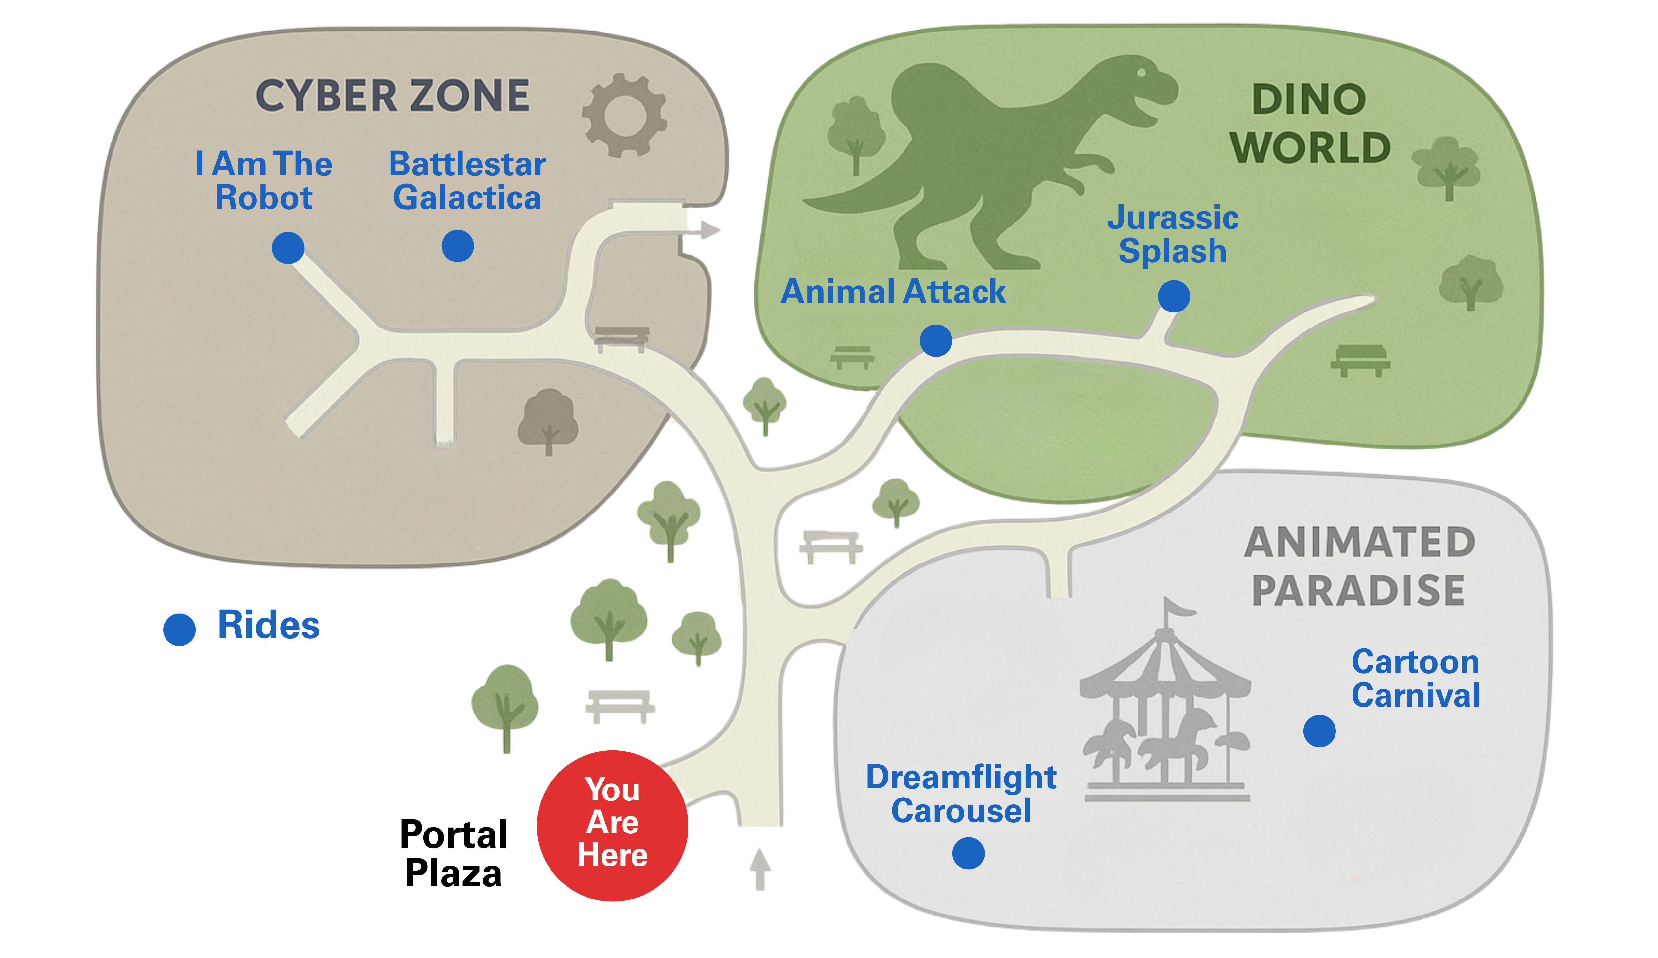
Sunday, 7 December 2025
Kiosk: P1
Rides
Shows
Food
Wait times
Refresh
Filters:
Updated: 1 min ago
Expand
Expand
––––––––– All Attractions List –––––––––
750m away
Map
The Robot King, 750m away
📍Cyber Zone, Shows
Add To Plan
EMOTION ENGINE
10 min
28 min
Battlestar Galactica, 800m away
10 min
5 min
📍Cyber Zone, Rides
Add To Plan
Directions
I Am The Robot, 880m away
📍Cyber Zone, Rides
Add To Plan
1
30 min
Byte Bites Cafe, 910m away
Plan
📍Cyber Zone, Food
Add To Plan
3 min
Neon Noodles, 870m away
📍Cyber Zone, Food
Add To Plan
History
––––––––– My Plan –––––––––
Animal Attack, 680m away
Animal Attack, 680m away
Added: 10 min ago
📍Dino World, Rides
Remove Plan
1.
📍Dino World, Rides
Remove Plan
Jurassic Splash, 720m away
📍Dino World, Rides
Add To Plan
Dino Roar! Live, 940m away
📍Dino World, Shows
Add To Plan
Logout
Notes:
Background: https://commons.wikimedia.org/wiki/File:Backgorund.gif
Map generated by Gen_AI (ChatGPT), further edited using Canva

Slide 15

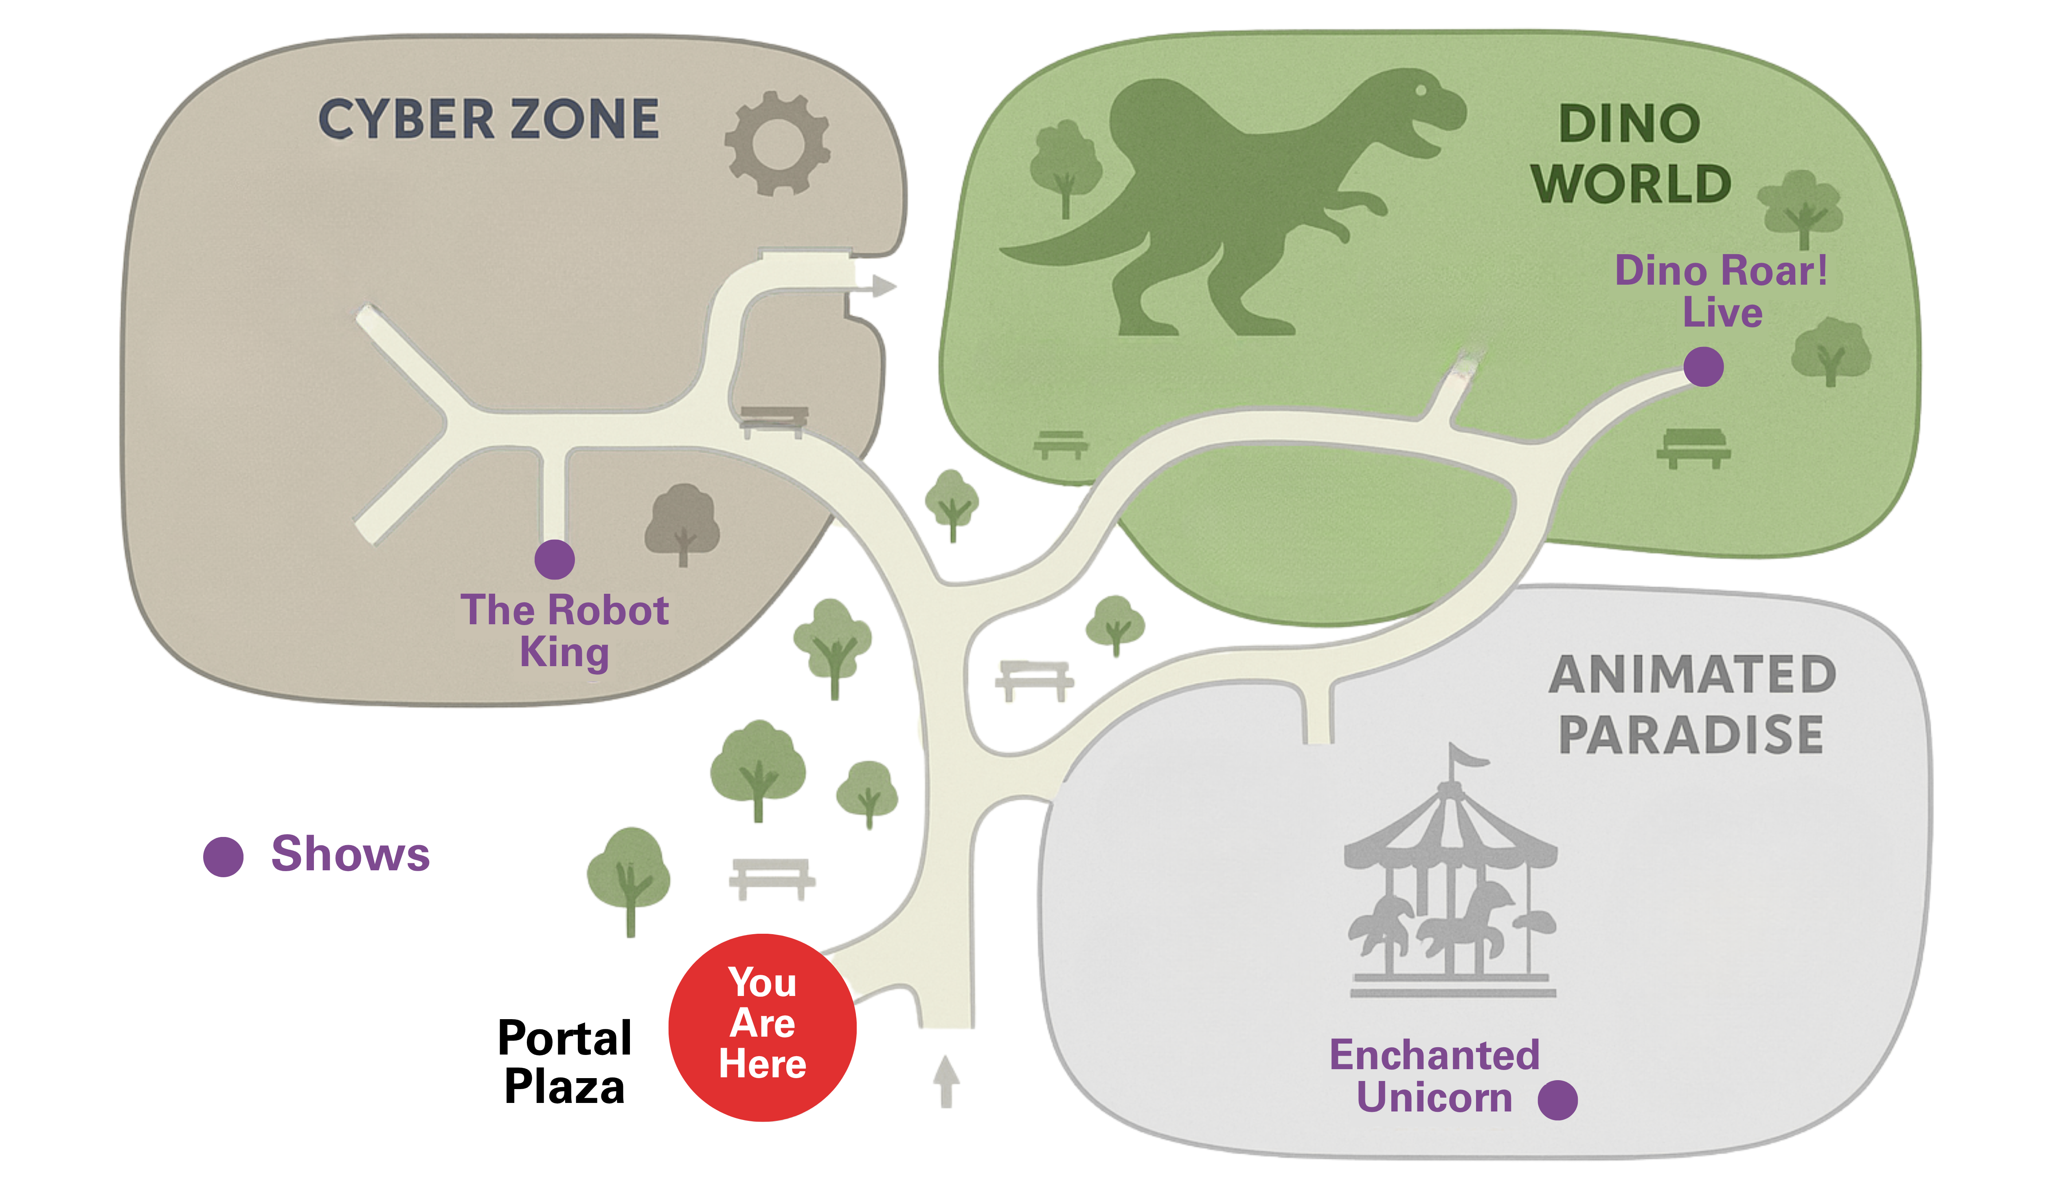
Sunday, 7 December 2025
Kiosk: P1
Rides
Shows
Food
Wait times
Refresh
Filters:
Updated: 1 min ago
Expand
Expand
––––––––– All Attractions List –––––––––
750m away
Map
The Robot King, 750m away
📍Cyber Zone, Shows
Add To Plan
EMOTION ENGINE
15 min
Battlestar Galactica, 800m away
8 min
📍Cyber Zone, Rides
Add To Plan
Directions
I Am The Robot, 880m away
📍Cyber Zone, Rides
Add To Plan
1
Byte Bites Cafe, 910m away
Plan
📍Cyber Zone, Food
Add To Plan
20 min
Neon Noodles, 870m away
📍Cyber Zone, Food
Add To Plan
History
––––––––– My Plan –––––––––
Animal Attack, 680m away
Animal Attack, 680m away
Added: 10 min ago
📍Dino World, Rides
Remove Plan
1.
📍Dino World, Rides
Remove Plan
Jurassic Splash, 720m away
📍Dino World, Rides
Add To Plan
Dino Roar! Live, 940m away
📍Dino World, Shows
Add To Plan
Logout
Notes:
Background: https://commons.wikimedia.org/wiki/File:Backgorund.gif
Map generated by Gen_AI (ChatGPT), further edited using Canva

Slide 16
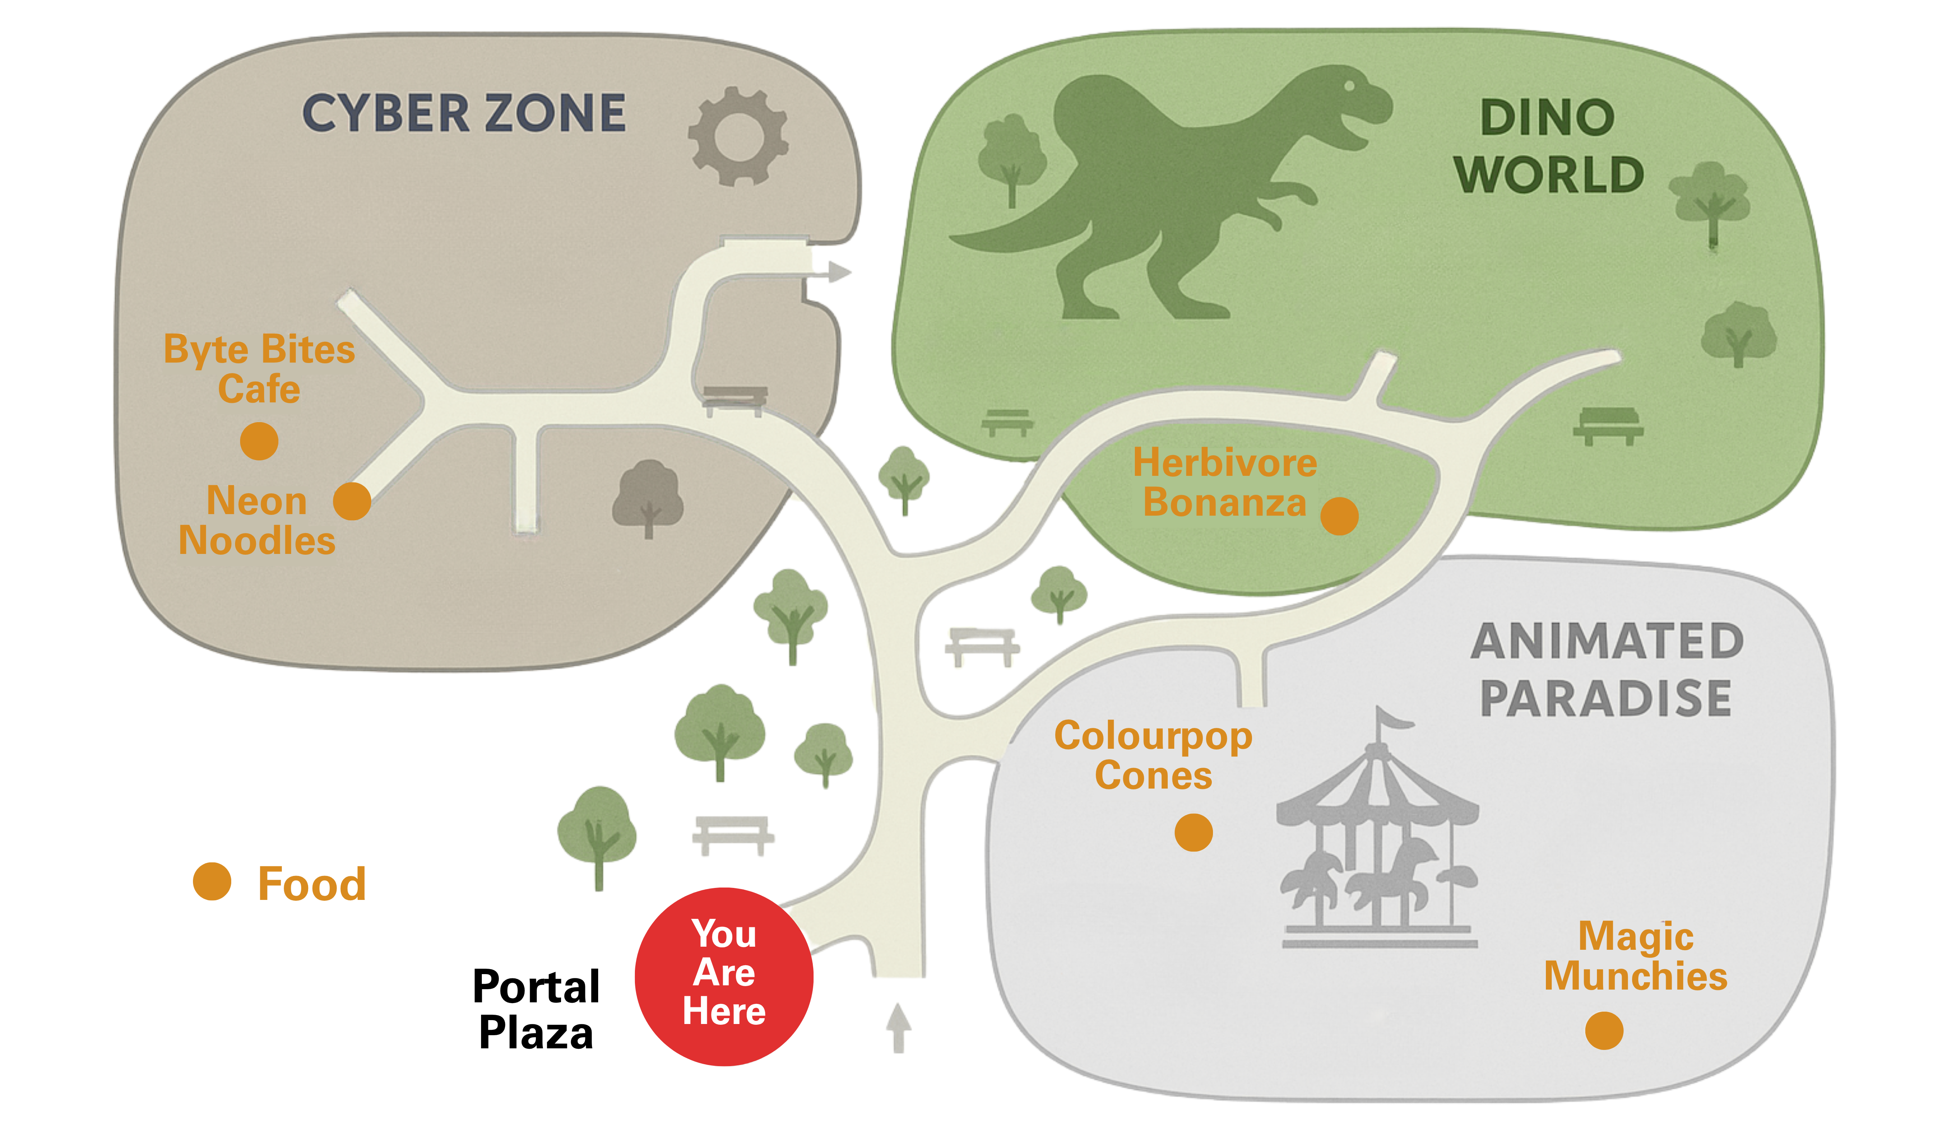
Sunday, 7 December 2025
Kiosk: P1
Rides
Shows
Food
Wait times
Refresh
Filters:
Updated: 1 min ago
Expand
Expand
––––––––– All Attractions List –––––––––
750m away
Map
The Robot King, 750m away
📍Cyber Zone, Shows
Add To Plan
EMOTION ENGINE
Battlestar Galactica, 800m away
📍Cyber Zone, Rides
Add To Plan
Directions
I Am The Robot, 880m away
📍Cyber Zone, Rides
Add To Plan
1
Byte Bites Cafe, 910m away
Plan
📍Cyber Zone, Food
Add To Plan
Neon Noodles, 870m away
📍Cyber Zone, Food
Add To Plan
History
––––––––– My Plan –––––––––
Animal Attack, 680m away
Animal Attack, 680m away
Added: 10 min ago
📍Dino World, Rides
Remove Plan
1.
📍Dino World, Rides
Remove Plan
Jurassic Splash, 720m away
📍Dino World, Rides
Add To Plan
Dino Roar! Live, 940m away
📍Dino World, Shows
Add To Plan
Logout
Notes:
Background: https://commons.wikimedia.org/wiki/File:Backgorund.gif
Map generated by Gen_AI (ChatGPT), further edited using Canva

Slide 17


Sunday, 7 December 2025
Kiosk: P1
Rides
Shows
Food
Wait
Refresh
Collapse
Expand
1 min ago
EMOTION ENGINE
Map
Directions
1
YOU ARE: HAPPY
Plan
Auto-detection
History
––––––––– My Plan –––––––––
––––––––– Suggestions –––––––––
1.
Animal Attack, 680m away
Added: 10 min ago
Neon Noodles, 870m away
📍Dino World, Rides
Remove Plan
📍Cyber Zone, Food
Add To Plan
Jurassic Splash, 720m away
📍Dino World, Rides
Add To Plan
Dino Roar! Live, 940m away
📍Dino World, Shows
Add To Plan
Logout
Notes:
Background: https://commons.wikimedia.org/wiki/File:Backgorund.gif
Map generated by Gen_AI (ChatGPT), further edited using Canva
Woman portrait from Microsoft Powerpoint Stock Images (search: ”female happy”)

Slide 18

Sunday, 7 December 2025
Kiosk: P1
Rides
Shows
Food
Wait
Refresh
Collapse
Expand
1 min ago
EMOTION ENGINE
Turn on Auto-detection
Map
Directions
1
Change your mood:
HAPPY
Plan
Auto-detection
History
––––––––– My Plan –––––––––
––––––––– Suggestions –––––––––
1.
Animal Attack, 680m away
Added: 10 min ago
Neon Noodles, 870m away
📍Dino World, Rides
Remove Plan
📍Cyber Zone, Food
Add To Plan
Jurassic Splash, 720m away
📍Dino World, Rides
Add To Plan
Dino Roar! Live, 940m away
📍Dino World, Shows
Add To Plan
Logout
Notes:
Background: https://commons.wikimedia.org/wiki/File:Backgorund.gif
Map generated by Gen_AI (ChatGPT), further edited using Canva

Slide 19
Sunday, 7 December 2025
Kiosk: P1
Rides
Shows
Food
Wait
Refresh
Collapse
Expand
1 min ago
EMOTION ENGINE
Turn on Auto-detection
Map
Directions
1
Change your mood:
HAPPY
Plan
HAPPY
CONTENT
RELAXED
TIRED
BORED
ANNOYED
ANGRY
MISERABLE
Auto-detection
History
––––––––– My Plan –––––––––
––––––––– Suggestions –––––––––
1.
Animal Attack, 680m away
Added: 10 min ago
Neon Noodles, 870m away
📍Dino World, Rides
Remove Plan
📍Cyber Zone, Food
Add To Plan
Jurassic Splash, 720m away
📍Dino World, Rides
Add To Plan
Dino Roar! Live, 940m away
📍Dino World, Shows
Add To Plan
Logout
Notes:
Background: https://commons.wikimedia.org/wiki/File:Backgorund.gif
Map generated by Gen_AI (ChatGPT), further edited using Canva

Slide 20



Sunday, 7 December 2025
Kiosk: P1
Rides
Shows
Food
Wait
Refresh
Collapse
Expand
1 min ago
EMOTION ENGINE
Map
Directions
1
YOU ARE: HAPPY
Plan
Auto-detection
History
––––––––– Directions to: –––––––––
––––––––– Suggestions –––––––––
Search an attraction…
Neon Noodles, 870m away
📍Cyber Zone, Food
Add To Plan
Jurassic Splash, 720m away
📍Dino World, Rides
Add To Plan
Dino Roar! Live, 940m away
📍Dino World, Shows
Add To Plan
Logout
Notes:
Background: https://commons.wikimedia.org/wiki/File:Backgorund.gif
Map generated by Gen_AI (ChatGPT), further edited using Canva
Woman portrait from Microsoft Powerpoint Stock Images (search: ”female happy”)

Slide 21





Sunday, 7 December 2025
Kiosk: P1
––––––––– Your Itinerary: –––––––––
Collapse
Expand
EMOTION ENGINE
Edit
Wait Time
Activity Time
Added By
Map
Animal Attack
📍Dino World, Rides
10 min
6 min
Nicole
Remove Plan
Directions
1
YOU ARE: HAPPY
Plan
Auto-detection
History
––––––––– Suggestions –––––––––
Total:
10 min
6 min
Neon Noodles, 870m away
📍Cyber Zone, Food
Add To Plan
0 h 16 min
Jurassic Splash, 720m away
📍Dino World, Rides
Add To Plan
Dino Roar! Live, 940m away
📍Dino World, Shows
Add To Plan
Logout
Notes:
Background: https://commons.wikimedia.org/wiki/File:Backgorund.gif
Map generated by Gen_AI (ChatGPT), further edited using Canva
Woman portrait from Microsoft Powerpoint Stock Images (search: ”female happy”)

Slide 22


Sunday, 7 December 2025
Kiosk: P1
Rides
Shows
Food
Wait times
Refresh
Collapse
Filters:
Updated: 1 min ago
Expand
––– All Attractions List –––
Map
Park Map
The Robot King, …
📍Cyber Zone, Shows
Add
EMOTION ENGINE
Directions
Battlestar Galactic…
📍Cyber Zone, Rides
Add
How to go
I Am The Robot, …
📍Cyber Zone, Rides
Add
1
Plan
Byte Bites Café, …
Plan itinerary
📍Cyber Zone, Food
Add
Neon Noodles, …
History
📍Cyber Zone, Food
Add
Past interactions
––––––––– My Plan –––––––––
Animal Attack, …
Animal Attack, 680m away
Added: 10 min ago
📍Dino World, Rides
Remove
1.
📍Dino World, Rides
Remove Plan
Jurassic Splash, …
📍Dino World, Rides
Add
Dino Roar! Live, …
📍Dino World, Shows
Add
Logout
Notes:
Background: https://commons.wikimedia.org/wiki/File:Backgorund.gif
Map generated by Gen_AI (ChatGPT), further edited using Canva

Slide 23
Sunday, 7 December 2025
Kiosk: P1
Rides
Shows
Food
Wait times
Refresh
Collapse
Filters:
Updated: 1 min ago
Expand
––– All Attractions List –––
Map
Park Map
The Robot King, …
📍Cyber Zone, Shows
Add
EMOTION ENGINE
Directions
Battlestar Galactic…
📍Cyber Zone, Rides
Add
How to go
I Am The Robot, …
📍Cyber Zone, Rides
Add
1
Plan
Byte Bites Café, …
Plan itinerary
📍Cyber Zone, Food
Add
Neon Noodles, …
History
📍Cyber Zone, Food
Add
Past interactions
––––––––– Directions to: –––––––––
Animal Attack, …
Search an attraction…
📍Dino World, Rides
Remove
Jurassic Splash, …
📍Dino World, Rides
Add
Dino Roar! Live, …
📍Dino World, Shows
Add
Logout
Notes:
Background: https://commons.wikimedia.org/wiki/File:Backgorund.gif
Map generated by Gen_AI (ChatGPT), further edited using Canva

Slide 24
Sunday, 7 December 2025
Kiosk: P1
Collapse
––––––––– Your Itinerary: –––––––––
––– All Attractions List –––
The Robot King, …
Expand
Edit
📍Cyber Zone, Shows
Add
Map
Wait Time
Activity Time
Added By
Battlestar Galactic…
Park Map
📍Cyber Zone, Rides
Add
EMOTION ENGINE
Animal Attack
📍Dino World, Rides
10 min
6 min
Nicole
I Am The Robot, …
Remove Plan
Directions
📍Cyber Zone, Rides
Add
How to go
Byte Bites Café, …
📍Cyber Zone, Food
Add
1
Plan
Neon Noodles, …
📍Cyber Zone, Food
Add
Plan itinerary
Animal Attack, …
📍Dino World, Rides
Remove
History
Past interactions
Jurassic Splash, …
📍Dino World, Rides
Add
Total:
10 min
6 min
Dino Roar! Live, …
📍Dino World, Shows
Add
0 h 16 min
Colourpop Cones, …
📍Animated Paradise, …
Add
Cartoon Carnival, …
📍Animated Paradise, …
Logout
Add
Notes:
Background: https://commons.wikimedia.org/wiki/File:Backgorund.gif

Slide 25


Sunday, 7 December 2025
Kiosk: P1
Collapse
––––––––– History (Past Interactions) –––––––––
Time
Kiosk No.
Done By
Summary
Map
11:35
P1
Nicole
Planned 2 new activities, used emotion engine
Park Map
More Details
11:20
P2
Chelsea
Navigate to Dino World
More Details
Directions
How to go
1
Plan
Plan itinerary
History
Past interactions
Logout
Notes:
Background: https://commons.wikimedia.org/wiki/File:Backgorund.gif

Slide 26
Sunday, 7 December 2025
Kiosk: P1
Rides
Shows
Food
Wait times
Refresh
Filters:
Updated: 1 min ago
Expand
Expand
––––––––– All Attractions List –––––––––
Map
The Robot King, 750m away
📍Cyber Zone, Shows
Add To Plan
EMOTION ENGINE
Battlestar Galactica, 800m away
📍Cyber Zone, Rides
Add To Plan
Directions
I Am The Robot, 880m away
📍Cyber Zone, Rides
Add To Plan
1
Byte Bites Cafe, 910m away
Plan
📍Cyber Zone, Food
Add To Plan
Neon Noodles, 870m away
📍Cyber Zone, Food
Add To Plan
History
––––––––– Directions to: –––––––––
Animal Attack, 680m away
Search an attraction…
📍Dino World, Rides
Remove Plan
Jurassic Splash, 720m away
📍Dino World, Rides
Add To Plan
Dino Roar! Live, 940m away
📍Dino World, Shows
Add To Plan
Logout
Notes:
Background: https://commons.wikimedia.org/wiki/File:Backgorund.gif
Map generated by Gen_AI (ChatGPT), further edited using Canva

Slide 27
Sunday, 7 December 2025
Kiosk: P1
Rides
Shows
Food
Wait times
Refresh
Filters:
Updated: 1 min ago
Expand
Expand
––––––––– All Attractions List –––––––––
Map
The Robot King, 750m away
📍Cyber Zone, Shows
Add To Plan
EMOTION ENGINE
Battlestar Galactica, 800m away
📍Cyber Zone, Rides
Add To Plan
Directions
I Am The Robot, 880m away
📍Cyber Zone, Rides
Add To Plan
1
Byte Bites Cafe, 910m away
Plan
📍Cyber Zone, Food
Add To Plan
Neon Noodles, 870m away
📍Cyber Zone, Food
Add To Plan
History
––––––––– Directions to: –––––––––
Animal Attack, 680m away
The Robo|
📍Dino World, Rides
Remove Plan
Jurassic Splash, 720m away
The Robot King, 750m away
📍Dino World, Rides
Add To Plan
1.
📍Cyber Zone, Shows
Add To Plan
Dino Roar! Live, 940m away
I Am The Robot, 880m away
📍Dino World, Shows
Add To Plan
2.
📍Cyber Zone, Rides
Add To Plan
Logout
Notes:
Background: https://commons.wikimedia.org/wiki/File:Backgorund.gif
Map generated by Gen_AI (ChatGPT), further edited using Canva

Slide 28

Sunday, 7 December 2025
Kiosk: P1
Rides
Shows
Food
Wait times
Refresh
Filters:
Updated: 1 min ago
Expand
Expand
––––––––– Directions to: –––––––––
The Robot King, 750m away
Map
The Robot King
📍Cyber Zone, Shows
Add To Plan
EMOTION ENGINE
Close
📍Cyber Zone, Shows
Battlestar Galactica, 800m away
750m away
📍Cyber Zone, Rides
Add To Plan
Directions
ⓘ Details:
I Am The Robot, 880m away
📍Cyber Zone, Rides
Add To Plan
A 15-minute hologram-and-laser stage show where the benevolent Robot King battles a rogue AI to save Multiverse Studios. Expect synchronised drones, projection mapping, and audience call-and-response …
1
Byte Bites Cafe, 910m away
Plan
📍Cyber Zone, Food
Add To Plan
Watch Trailer
More Info
Neon Noodles, 870m away
📍Cyber Zone, Food
Add To Plan
Add To Plan
History
––––––––– Directions to: –––––––––
Animal Attack, 680m away
The Robot King
📍Dino World, Rides
Remove Plan
Jurassic Splash, 720m away
The Robot King, 750m away
📍Dino World, Rides
Add To Plan
1.
📍Cyber Zone, Shows
Add To Plan
Dino Roar! Live, 940m away
I Am The Robot, 880m away
📍Dino World, Shows
Add To Plan
2.
📍Cyber Zone, Rides
Add To Plan
Logout
Notes:
Background: https://commons.wikimedia.org/wiki/File:Backgorund.gif
Map generated by Gen_AI (ChatGPT), further edited using Canva

Slide 29
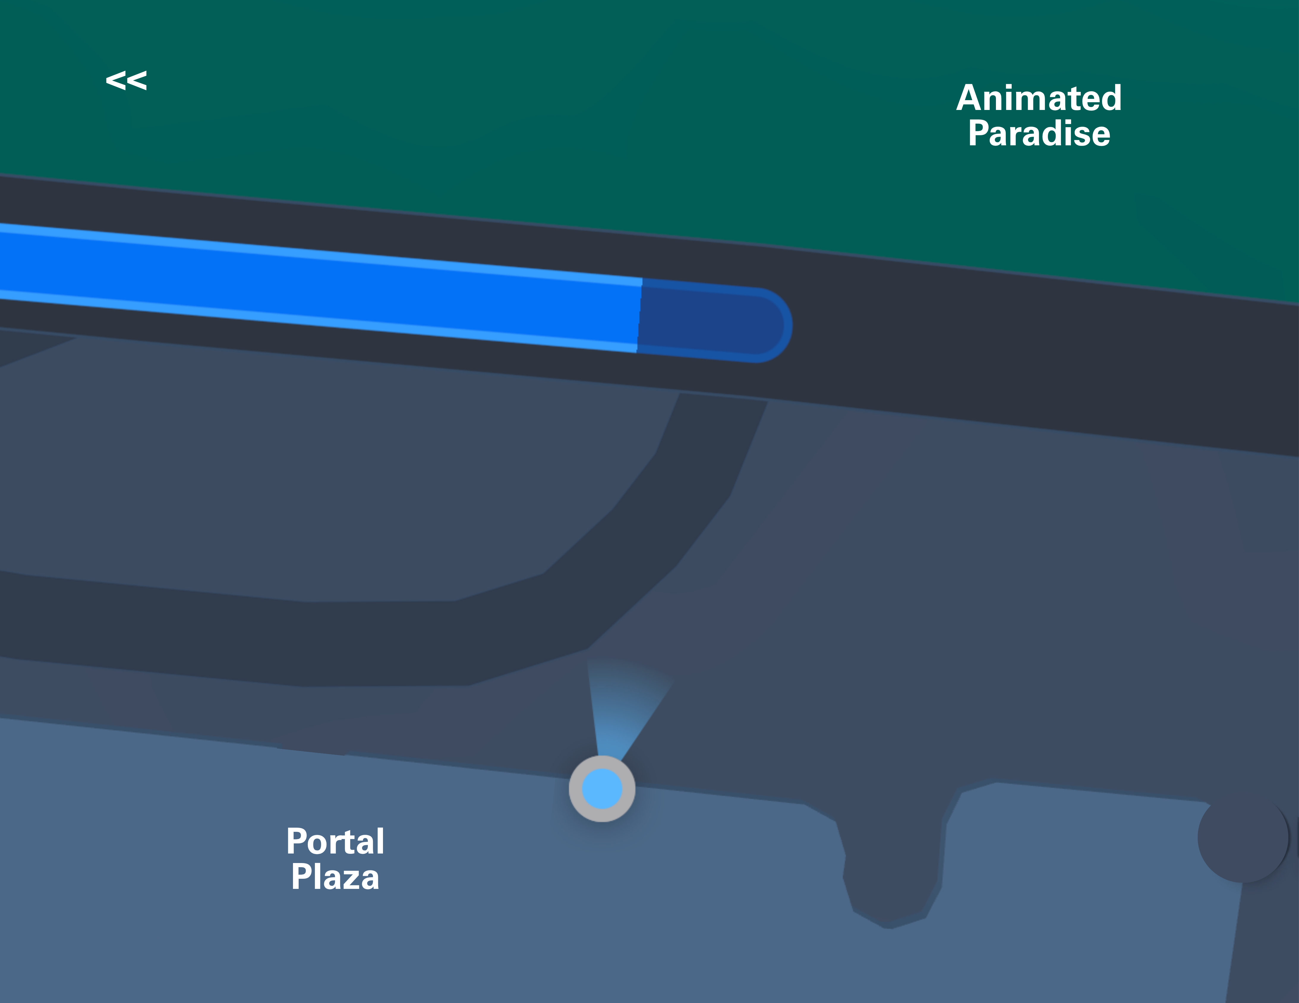
Sunday, 7 December 2025
Kiosk: P1
Rides
Shows
Food
Wait times
Refresh
Filters:
Updated: 1 min ago
Expand
Expand
––––––––– Directions to: –––––––––
The Robot King, 750m away
Map
The Robot King
📍Cyber Zone, Shows
Add To Plan
EMOTION ENGINE
Close
📍Cyber Zone, Shows
Battlestar Galactica, 800m away
750m away
📍Cyber Zone, Rides
Add To Plan
Directions
ⓘ Details:
I Am The Robot, 880m away
📍Cyber Zone, Rides
Add To Plan
A 15-minute hologram-and-laser stage show where the benevolent Robot King battles a rogue AI to save Multiverse Studios. Expect synchronised drones, projection mapping, and audience call-and-response …
1
Byte Bites Cafe, 910m away
Plan
📍Cyber Zone, Food
Add To Plan
Watch Trailer
More Info
Neon Noodles, 870m away
📍Cyber Zone, Food
Add To Plan
Add To Plan
History
––––––––– Directions to: –––––––––
Animal Attack, 680m away
The Robot King
📍Dino World, Rides
Remove Plan
Jurassic Splash, 720m away
The Robot King, 750m away
📍Dino World, Rides
Add To Plan
1.
📍Cyber Zone, Shows
Add To Plan
Dino Roar! Live, 940m away
I Am The Robot, 880m away
📍Dino World, Shows
Add To Plan
2.
📍Cyber Zone, Rides
Add To Plan
Logout
Notes:
Background: https://commons.wikimedia.org/wiki/File:Backgorund.gif
Map from Apple Maps screenshot, further edited using Canva

Slide 30
Sunday, 7 December 2025
Kiosk: P1
––––––––– Your Itinerary: –––––––––
––––––––– All Attractions List –––––––––
Expand
The Robot King, 750m away
Expand
Edit
📍Cyber Zone, Shows
Add To Plan
Wait Time
Activity Time
Added By
Battlestar Galactica, 800m away
Map
📍Cyber Zone, Rides
Add To Plan
EMOTION ENGINE
Animal Attack
📍Dino World, Rides
10 min
6 min
Nicole
I Am The Robot, 880m away
Remove Plan
📍Cyber Zone, Rides
Add To Plan
Directions
Byte Bites Cafe, 910m away
📍Cyber Zone, Food
Add To Plan
1
Neon Noodles, 870m away
📍Cyber Zone, Food
Add To Plan
Plan
Animal Attack, 680m away
📍Dino World, Rides
Remove Plan
Jurassic Splash, 720m away
History
📍Dino World, Rides
Add To Plan
Total:
10 min
6 min
Dino Roar! Live, 940m away
📍Dino World, Shows
Add To Plan
0 h 16 min
Colourpop Cones, 240m away
📍Animated Paradise, Food
Add To Plan
Cartoon Carnival, 300m away
📍Animated Paradise, Rides
Add To Plan
Logout
Notes:
Background: https://commons.wikimedia.org/wiki/File:Backgorund.gif

Slide 31
Sunday, 7 December 2025
Kiosk: P1
––––––––– Your Itinerary: –––––––––
––––––––– All Attractions List –––––––––
Expand
The Robot King, 750m away
Expand
Edit
📍Cyber Zone, Shows
Add To Plan
Wait Time
Activity Time
Added By
Battlestar Galactica, 800m away
Map
📍Cyber Zone, Rides
Add To Plan
EMOTION ENGINE
Animal Attack
📍Dino World, Rides
10 min
6 min
Nicole
I Am The Robot, 880m away
Remove Plan
Close
ⓘ
📍Cyber Zone, Rides
Add To Plan
Directions
Byte Bites Cafe, 910m away
Confirm remove plan:
📍Cyber Zone, Food
Add To Plan
1
Neon Noodles, 870m away
Animal Attack
📍Cyber Zone, Food
Add To Plan
Plan
📍Dino World, Rides
Animal Attack, 680m away
Cancel
Confirm
📍Dino World, Rides
Remove Plan
Jurassic Splash, 720m away
History
📍Dino World, Rides
Add To Plan
Total:
10 min
6 min
Dino Roar! Live, 940m away
📍Dino World, Shows
Add To Plan
0 h 16 min
Colourpop Cones, 240m away
📍Animated Paradise, Food
Add To Plan
Cartoon Carnival, 300m away
📍Animated Paradise, Rides
Add To Plan
Logout
Notes:
Background: https://commons.wikimedia.org/wiki/File:Backgorund.gif

Slide 32
Sunday, 7 December 2025
Kiosk: P1
––––––––– Your Itinerary: –––––––––
––––––––– All Attractions List –––––––––
Expand
The Robot King, 750m away
Expand
Edit
📍Cyber Zone, Shows
Add To Plan
Wait Time
Activity Time
Added By
Battlestar Galactica, 800m away
Map
📍Cyber Zone, Rides
Add To Plan
EMOTION ENGINE
I Am The Robot, 880m away
📍Cyber Zone, Rides
Add To Plan
Directions
Byte Bites Cafe, 910m away
📍Cyber Zone, Food
Add To Plan
Neon Noodles, 870m away
📍Cyber Zone, Food
Add To Plan
Plan
Animal Attack, 680m away
📍Dino World, Rides
Add To Plan
Jurassic Splash, 720m away
History
📍Dino World, Rides
Add To Plan
Total:
0 min
0 min
Dino Roar! Live, 940m away
📍Dino World, Shows
Add To Plan
0 h 0 min
Colourpop Cones, 240m away
📍Animated Paradise, Food
Add To Plan
Cartoon Carnival, 300m away
📍Animated Paradise, Rides
Add To Plan
Logout
Notes:
Background: https://commons.wikimedia.org/wiki/File:Backgorund.gif

Slide 33
Sunday, 7 December 2025
Kiosk: P1
Activity removed – Undo?
––––––––– Your Itinerary: –––––––––
––––––––– All Attractions List –––––––––
Expand
The Robot King, 750m away
Expand
Edit
📍Cyber Zone, Shows
Add To Plan
Wait Time
Activity Time
Added By
Battlestar Galactica, 800m away
Map
📍Cyber Zone, Rides
Add To Plan
EMOTION ENGINE
I Am The Robot, 880m away
📍Cyber Zone, Rides
Add To Plan
Directions
Byte Bites Cafe, 910m away
📍Cyber Zone, Food
Add To Plan
Neon Noodles, 870m away
📍Cyber Zone, Food
Add To Plan
Plan
Animal Attack, 680m away
📍Dino World, Rides
Add To Plan
Jurassic Splash, 720m away
History
📍Dino World, Rides
Add To Plan
Total:
0 min
0 min
Dino Roar! Live, 940m away
📍Dino World, Shows
Add To Plan
0 h 0 min
Colourpop Cones, 240m away
📍Animated Paradise, Food
Add To Plan
Cartoon Carnival, 300m away
📍Animated Paradise, Rides
Add To Plan
Logout
Notes:
Background: https://commons.wikimedia.org/wiki/File:Backgorund.gif

Slide 34
Sunday, 7 December 2025
Kiosk: P1
––––––––– Your Itinerary: –––––––––
––––––––– All Attractions List –––––––––
Expand
The Robot King, 750m away
Expand
Edit
📍Cyber Zone, Shows
Add To Plan
Wait Time
Activity Time
Added By
Battlestar Galactica, 800m away
Map
📍Cyber Zone, Rides
Add To Plan
EMOTION ENGINE
I Am The Robot, 880m away
📍Cyber Zone, Rides
Add To Plan
Directions
Byte Bites Cafe, 910m away
📍Cyber Zone, Food
Add To Plan
Neon Noodles, 870m away
📍Cyber Zone, Food
Add To Plan
Plan
Animal Attack, 680m away
📍Dino World, Rides
Add To Plan
Jurassic Splash, 720m away
History
📍Dino World, Rides
Add To Plan
Total:
0 min
0 min
Dino Roar! Live, 940m away
📍Dino World, Shows
Add To Plan
0 h 0 min
Colourpop Cones, 240m away
📍Animated Paradise, Food
Add To Plan
Cartoon Carnival, 300m away
📍Animated Paradise, Rides
Add To Plan
Logout
Notes:
Background: https://commons.wikimedia.org/wiki/File:Backgorund.gif

Slide 35
Sunday, 7 December 2025
Kiosk: P1
––––––––– Your Itinerary: –––––––––
––––––––– All Attractions List –––––––––
Expand
The Robot King, 750m away
Expand
Edit
📍Cyber Zone, Shows
Add To Plan
Wait Time
Activity Time
Added By
Battlestar Galactica, 800m away
Map
📍Cyber Zone, Rides
Add To Plan
EMOTION ENGINE
I Am The Robot, 880m away
Close
ⓘ
📍Cyber Zone, Rides
Add To Plan
Directions
Byte Bites Cafe, 910m away
Confirm add plan:
📍Cyber Zone, Food
Add To Plan
Neon Noodles, 870m away
Animal Attack
📍Cyber Zone, Food
Add To Plan
Plan
📍Dino World, Rides
Animal Attack, 680m away
Cancel
Confirm
📍Dino World, Rides
Add To Plan
Jurassic Splash, 720m away
History
📍Dino World, Rides
Add To Plan
Total:
0 min
0 min
Dino Roar! Live, 940m away
📍Dino World, Shows
Add To Plan
0 h 0 min
Colourpop Cones, 240m away
📍Animated Paradise, Food
Add To Plan
Cartoon Carnival, 300m away
📍Animated Paradise, Rides
Add To Plan
Logout
Notes:
Background: https://commons.wikimedia.org/wiki/File:Backgorund.gif

Slide 36
Sunday, 7 December 2025
Kiosk: P1
––––––––– Your Itinerary: –––––––––
––––––––– All Attractions List –––––––––
Expand
The Robot King, 750m away
Expand
Edit
📍Cyber Zone, Shows
Add To Plan
Wait Time
Activity Time
Added By
Battlestar Galactica, 800m away
Map
📍Cyber Zone, Rides
Add To Plan
EMOTION ENGINE
Animal Attack
📍Dino World, Rides
10 min
6 min
Nicole
I Am The Robot, 880m away
Remove Plan
📍Cyber Zone, Rides
Add To Plan
Directions
Byte Bites Cafe, 910m away
📍Cyber Zone, Food
Add To Plan
1
Neon Noodles, 870m away
📍Cyber Zone, Food
Add To Plan
Plan
Animal Attack, 680m away
📍Dino World, Rides
Remove Plan
Jurassic Splash, 720m away
History
📍Dino World, Rides
Add To Plan
Total:
10 min
6 min
Dino Roar! Live, 940m away
📍Dino World, Shows
Add To Plan
0 h 16 min
Colourpop Cones, 240m away
📍Animated Paradise, Food
Add To Plan
Cartoon Carnival, 300m away
📍Animated Paradise, Rides
Add To Plan
Logout
Notes:
Background: https://commons.wikimedia.org/wiki/File:Backgorund.gif

Slide 37
Sunday, 7 December 2025
Kiosk: P1
Activity added – Undo?
––––––––– Your Itinerary: –––––––––
––––––––– All Attractions List –––––––––
Expand
The Robot King, 750m away
Expand
Edit
📍Cyber Zone, Shows
Add To Plan
Wait Time
Activity Time
Added By
Battlestar Galactica, 800m away
Map
📍Cyber Zone, Rides
Add To Plan
EMOTION ENGINE
Animal Attack
📍Dino World, Rides
10 min
6 min
Nicole
I Am The Robot, 880m away
Remove Plan
📍Cyber Zone, Rides
Add To Plan
Directions
Byte Bites Cafe, 910m away
📍Cyber Zone, Food
Add To Plan
1
Neon Noodles, 870m away
📍Cyber Zone, Food
Add To Plan
Plan
Animal Attack, 680m away
📍Dino World, Rides
Remove Plan
Jurassic Splash, 720m away
History
📍Dino World, Rides
Add To Plan
Total:
10 min
6 min
Dino Roar! Live, 940m away
📍Dino World, Shows
Add To Plan
0 h 16 min
Colourpop Cones, 240m away
📍Animated Paradise, Food
Add To Plan
Cartoon Carnival, 300m away
📍Animated Paradise, Rides
Add To Plan
Logout
Notes:
Background: https://commons.wikimedia.org/wiki/File:Backgorund.gif

Slide 38

Sunday, 7 December 2025
Kiosk: P1
––––––––– Your Itinerary: –––––––––
––––––––– All Attractions List –––––––––
Expand
The Robot King, 750m away
Expand
Done
📍Cyber Zone, Shows
Add To Plan
Wait Time
Activity Time
Reorder / Delete
Battlestar Galactica, 800m away
Map
📍Cyber Zone, Rides
Add To Plan
EMOTION ENGINE
Animal Attack
📍Dino World, Rides
10 min
6 min
Remove
I Am The Robot, 880m away
Move Down
Move Up
📍Cyber Zone, Rides
Add To Plan
Directions
Byte Bites Cafe, 910m away
📍Cyber Zone, Food
Add To Plan
1
Neon Noodles, 870m away
📍Cyber Zone, Food
Add To Plan
Plan
Animal Attack, 680m away
📍Dino World, Rides
Remove Plan
Jurassic Splash, 720m away
History
📍Dino World, Rides
Add To Plan
Total:
10 min
6 min
Dino Roar! Live, 940m away
📍Dino World, Shows
Add To Plan
0 h 16 min
Colourpop Cones, 240m away
📍Animated Paradise, Food
Add To Plan
Cartoon Carnival, 300m away
📍Animated Paradise, Rides
Add To Plan
Logout
Notes:
Background: https://commons.wikimedia.org/wiki/File:Backgorund.gif

Slide 39
Sunday, 7 December 2025
Kiosk: P1
––––––––– History (Past Interactions) –––––––––
Expand
Time
Kiosk No.
Done By
Summary
11:35
P1
Nicole
Planned 2 new activities, used emotion engine
More Details
Map
11:20
P2
Chelsea
Navigate to Dino World
More Details
Directions
1
Plan
History
Logout
Notes:
Background: https://commons.wikimedia.org/wiki/File:Backgorund.gif

Slide 40
Sunday, 7 December 2025
Kiosk: P1
––––––––– History (Past Interactions) –––––––––
–– Details: ––––––––––––––––
Close
Expand
Summary
Time
Kiosk No.
Done By
Summary
Time: 11:35
Kiosk Number: P1, Portal Plaza, Main Entrance
Done By: Nicole
11:35
P1
Nicole
Planned 2 new activities, ...
Map
11:20
P2
Chelsea
Navigate to Dino World
Add activity: Animal Attack, 📍Dino World, Rides
Add activity: I Am The Robot, 📍Cyber Zone, Rides
Add activity: The Robot King, 📍Cyber Zone, Shows
View map
Navigate to: The Robot King, 📍Cyber Zone, Shows
Remove activity: The Robot King, 📍Cyber Zone, Shows
Remove activity: I Am The Robot, 📍Cyber Zone, Rides
View map
View plan
Scroll attractions list
Open emotion engine
Emotion detected: Happy
Watch trailer: I Am The Robot, 📍Cyber Zone, Rides
Search: Food @ Dino World
Directions
1
Plan
History
Logout
Notes:
Background: https://commons.wikimedia.org/wiki/File:Backgorund.gif

Slide 41
Sunday, 7 December 2025
Kiosk: P1
––––––––– History (Past Interactions) –––––––––
–– Details: ––––––––––––––––
Close
Expand
Summary
Time
Kiosk No.
Done By
Summary
Time: 11:20
Kiosk Number: P2, Portal Plaza, Side Entrance
Done By: Chelsea
11:35
P1
Nicole
Planned 2 new activities, ...
Map
11:20
P2
Chelsea
Navigate to Dino World
Watch trailer: Animal Attack, 📍Dino World, Rides
View map
Search: Animal Attack, 📍Dino World, Rides
Navigate to: Animal Attack, 📍Dino World, Rides
Toggle navigation view: Route to destination
Interact with navigation: Scroll and zoom
Toggle navigation view: 2D top view
Logout
Directions
1
Plan
History
Logout
Notes:
Background: https://commons.wikimedia.org/wiki/File:Backgorund.gif

